Slide 1


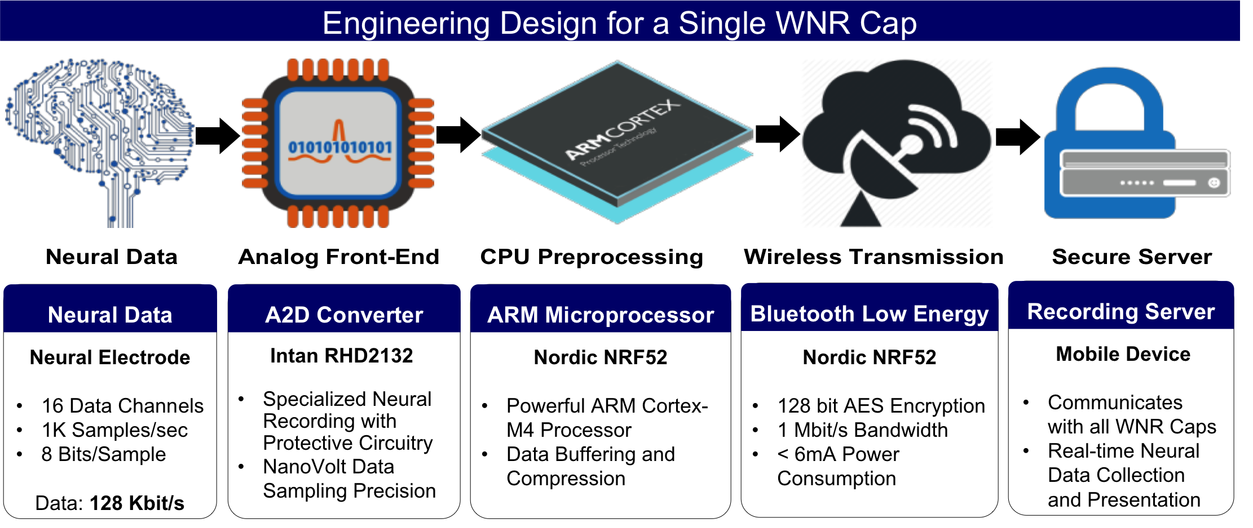
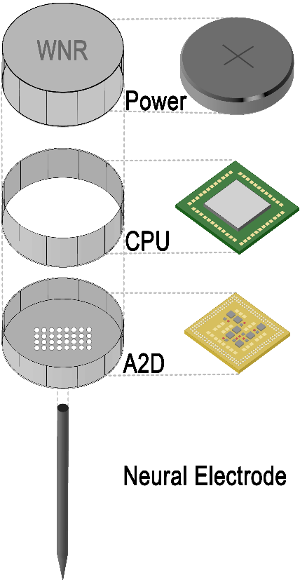
Energy-Efficient High-Throughput Wireless Transmission of Multi-Channel Neural Signals
Yuan Gao, Xin Huang, Tingkai Liu, Stephen Xia
Project Objective for Team Wireless Neural Recorder(WNR)
To develop an array of small, secure, high-throughput, low-power Wireless Neural Recorder(WNR) caps that can be screwed independently onto ECoG electrode for wireless transmission of neural data.
Assembly Diagram
Engineering Design for a Single WNR Cap

